Slide 1
Exploratory Data Analysis Project ‘Indian Startup Funding Trends’
Review 3
Gaurav Sharan – 20MIA1081
Anukeerthi R – 20MIA1160

Slide 2

1. Introduction
Title - Indian Startup Funding Trends
Broad Area – Analyzing investment pattern for Indian Startup ecosystem

Slide 3

2. Problem Statement & Objectives
Does location also play a role in determining the growth of a startup?
Who plays the main role in Indian startups ecosystem?
What are the different types of funding for startups?
Is heavy count in seed funding also means heavy amount?
Companies with most numbers of investors?
Is Funding depends on the number of investors?

Slide 4
3. Problem Statement & Objectives
(Time Series Part)
Total investments over time(in USD)
Year Quarter No – Year Month
Count of Investments over time
Year Quarter No – Year Month
When funding was declared?
What is the amount(in USD) start-ups are getting year quarter and year monthly wise?
Total variation of funding amount per month in period of 2015-2017?
How funding changed in 2015-2017 when it reached the peak monthly and quarterly wise?
How does Funding ecosystem change with respect to time?

Slide 5
4. Proposed Model/Diagram
Tentative Techniques:
Data Cleaning – handling missing data
Multivariate Visualization
Descriptive Analysis
Time series Analysis

Slide 6
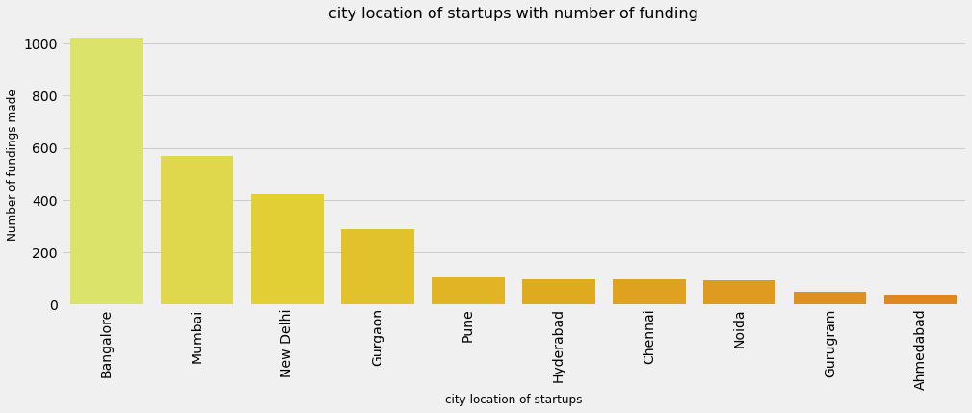
5. Result Analysis
Does location also play a role in determining the growth of a startup?

Slide 7
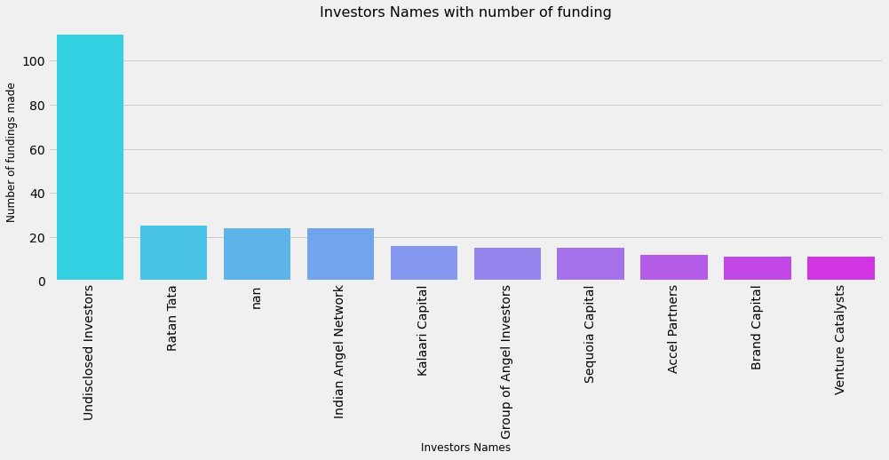
5. Result Analysis
Who plays the main role in Indian startups ecosystem?

Slide 8
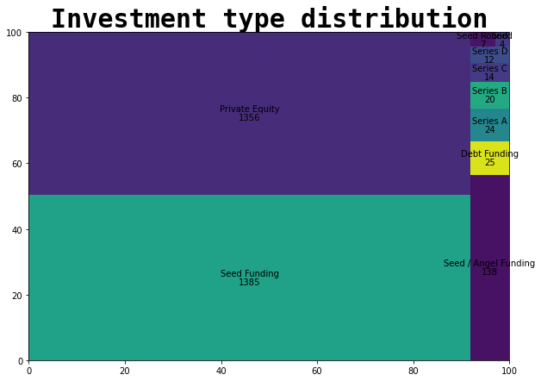
5. Result Analysis
What are the different types of funding for startups?

Slide 9
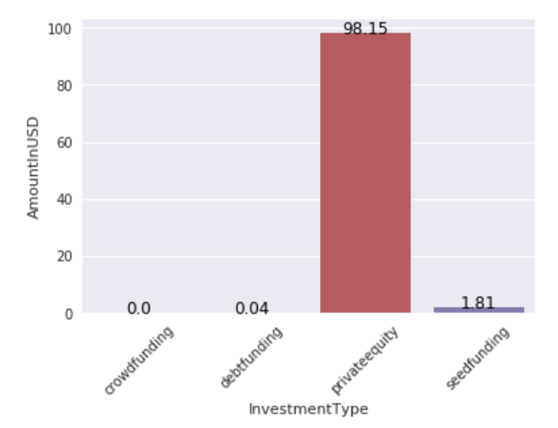
5. Result Analysis
Is heavy count in seed funding also means heavy amount?

Slide 10
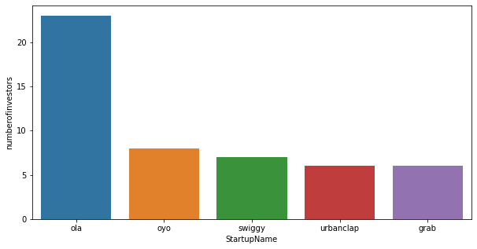
5. Result Analysis
Companies with most numbers of investors?

Slide 11
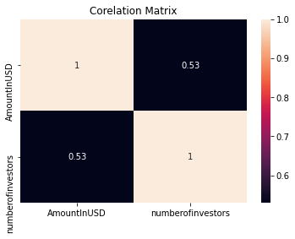
5. Result Analysis
Is Funding depends on the number of investors?

Slide 12
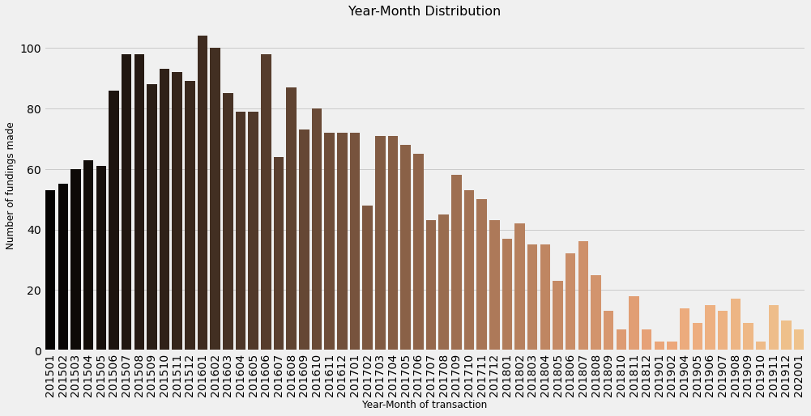
5. Result Analysis
(Time Series Part)
How does the funding ecosystem change with respect to time?

Slide 13
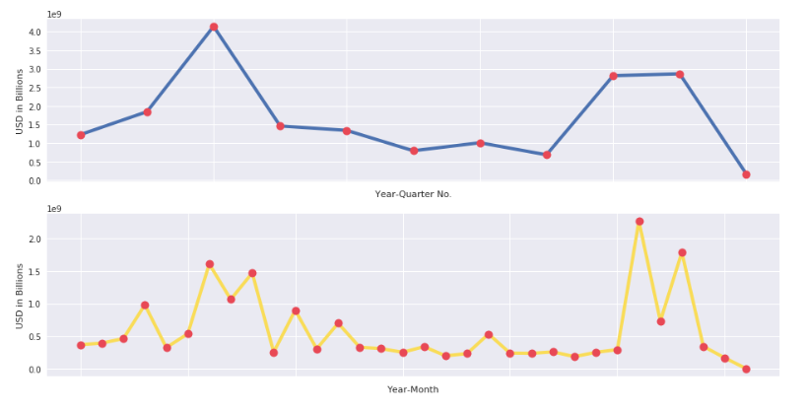
5. Result Analysis
(Time Series Part)
What is the amount(in USD) startups are getting year quarter and year monthly wise?

Slide 14
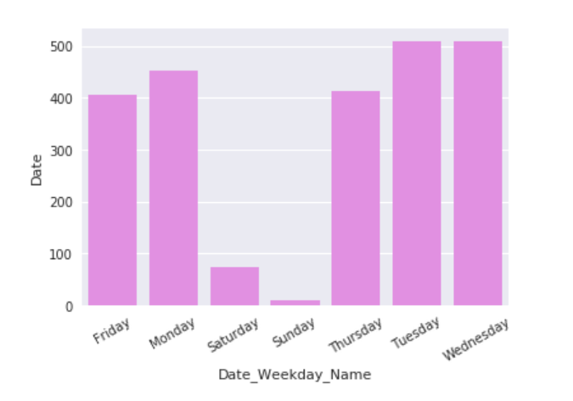
5. Result Analysis
(Time Series Part)
When funding was declared?

Slide 15
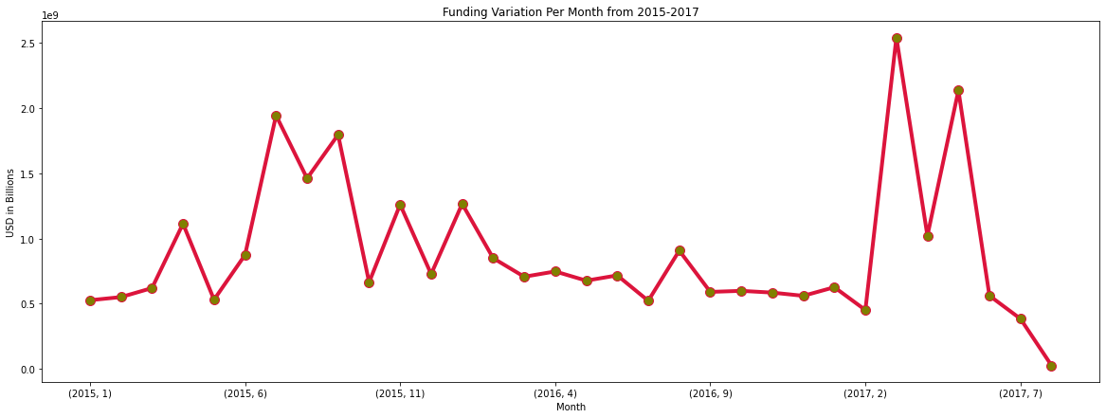
5. Result Analysis
(Time Series Part)
Total variation of funding amount per month in period of 2015-2017?

Slide 16
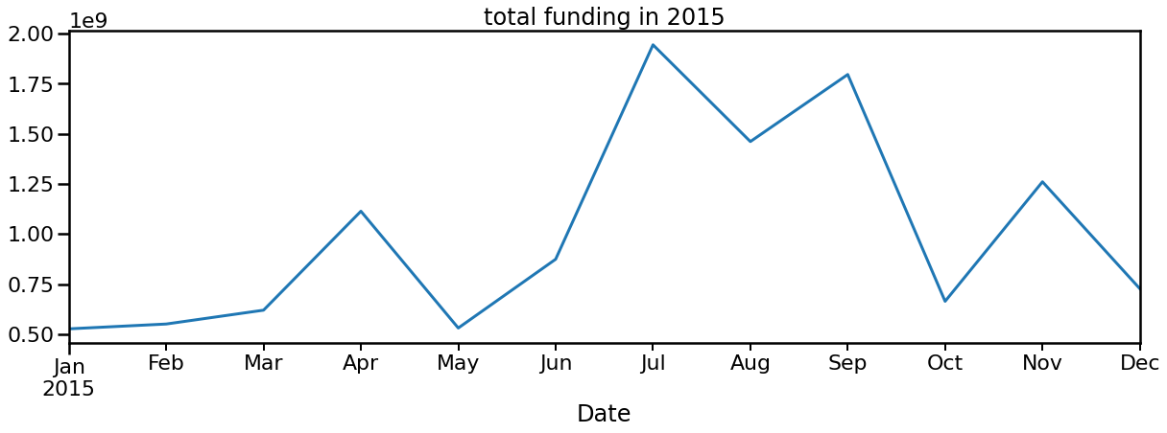
5. Result Analysis
(Time Series Part)
How funding changed in 2015-2017 when it reached the peak monthly and quarterly wise?
2015:

Slide 17
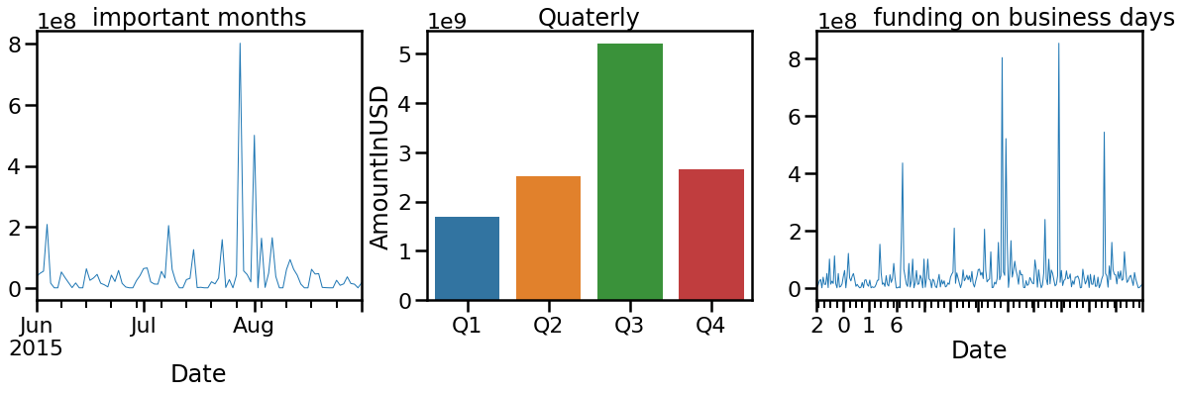
5. Result Analysis
(Time Series Part)
2015:

Slide 18
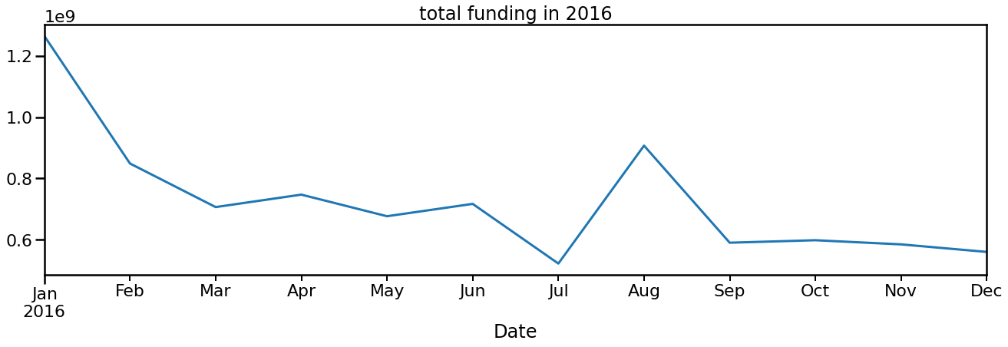
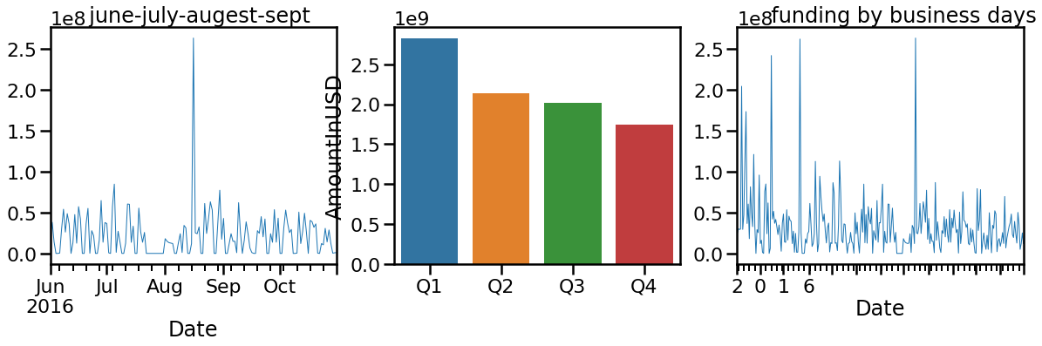
5. Result Analysis
2016:

Slide 19
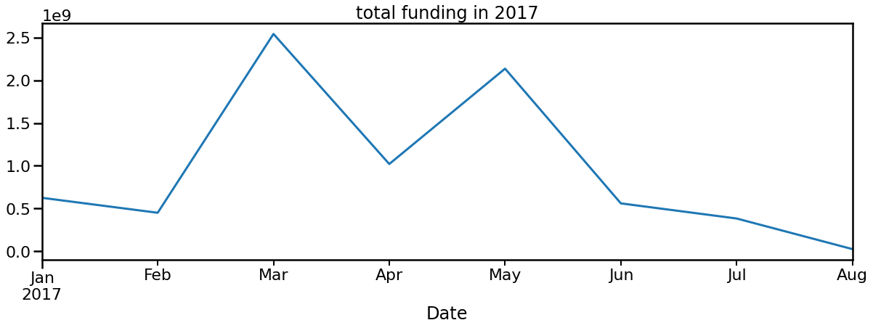
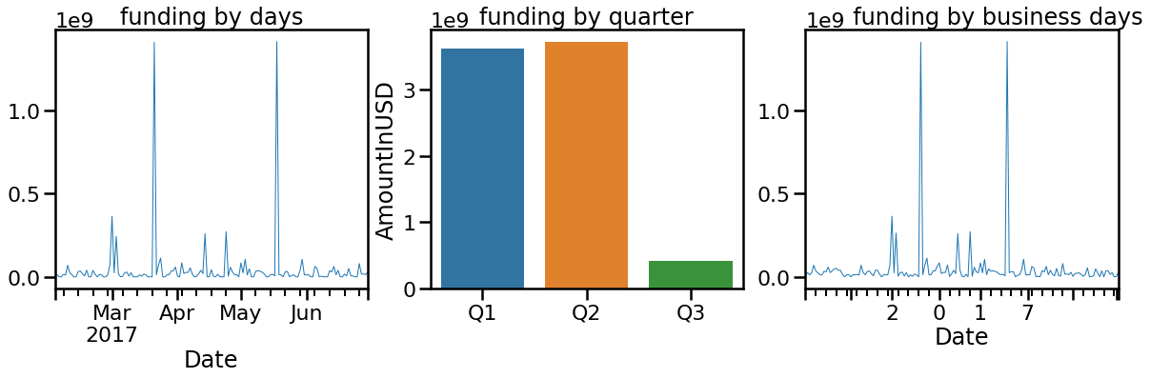
5. Result Analysis
2017:

Slide 20
6. Conclusion
Technology-based start-ups which provide their services to the everyday consumer are very probable to get a lot of funding.
A large number of Start-ups based in metropolitan cities are funded, which may be due to the fact of easy accessibility to all resources.
Most of the fundings are either of Private Equity and Seed Funding type.
Ratan Tata, Indian Angel Network, and Kalaari Capital are some of the top investors in the Indian startup ecosystem.
There was 50% relation between funded amount and number of investors per startup.
2016 had highest amount of investments. Over the year, during some periods the funding gets increased too much like 3rd quarter in 2015, September in 2016, March to May in 2017. The period is highly unpredictable.

Slide 21
Future Work:
In future we will apply machine learning algorithms for prediction analysis of fundings of start-ups.

Slide 22
6. References
https://towardsdatascience.com/
https://www.kaggle.com/
https://www.analyticsvidhya.com/blog/2022/01/10-best-data-science-websites-to-find-datasets-for-your-next-ds-project/
https://www.irjet.net/archives/V5/i11/IRJET-V5I11297.pdf
https://www.statisticssolutions.com/free-resources/directory-of-statistical-analyses/time-series-analysis/
https://www.coursera.org/in
https://www.statisticssolutions.com/free-resources/directory-of-statistical-analyses/time-series-analysis/
https://en.wikipedia.org/wiki/List_of_unicorn_startup_companies
https://en.wikipedia.org/wiki/Timeline_of_Indian_startup_ecosystem

Slide 23
6. References
https://www.investopedia.com/ask/answers/032515/what-does-it-mean-if-correlation-coefficient-positive-negative-or-zero.asp
https://www.investopedia.com/terms/t/timeseries.asp
https://www.machinelearningplus.com/time-series/time-series-analysis-python/
https://www.startupindia.gov.in/content/sih/en/international/go-to-market-guide/indian-startup-ecosystem.html
https://yourstory.com/2022/02/coming-age-indian-startup-ecosystem/amp

